Slide 1



Why You Should Post Content Under a Personal Name Versus a Company Name
Presented by:
ERP Software Blog
CRM Software Blog
ERP Cloud Blog
Presenter:
Jeff Foreman
jeff@erpsoftwareblog.com
December 12th, 2024

Slide 2
Topics
Google's Helpful Content System
Benefits of Personal Authorship
Implementation Strategies
Impact on SEO
Best Practices
Q&A

Slide 3
Google's Helpful Content System
  Launched: August 2022
  Major Updates:
  December 2022 Enhancement
  February 2023 Global Rollout
  October 2023 Effectiveness Update
  Google Quote: "Content should demonstrate first-hand experience and a depth of knowledge.
  This system represents a fundamental shift in how Google evaluates content quality.

Slide 4
Beyond Google:
Why Personal Authorship Matters
From Edelman 2023 Trust Barometer:
  Technical experts are most trusted.
  People like yourself rank higher in trust than corporate voices.
LinkedIn Engagement Data
  Employee posts: 2x higher click-through rates than corporate posts.

Slide 5
Human Authorship Aligns With Google’s
E-E-A-T Concept
Experience:
Personal Case Studies, Direct Involvement, Real-world Experiences
Expertise:
Professional Credentials, Verifiable Background, Specific Knowledge Areas, Continuing Education.
Authoritativeness:
Citations by other publishers, Industry Recognition, Published Content, Professional Affiliations, Awards and Achievements.
Trustworthiness:
Transparent Background, Verifiable Credentials, Updated Bio,

Slide 6
Implications for Content Generation
Individual authorship supports:
Detailed first-hand accounts
Specific expertise demonstrations
Clear accountability
Unique insights
Personal experiences
Specific examples
Direct knowledge

Slide 7
How Our Personal Authorship Tools Works
Enter your name and title
Add a link to your company bio page (or LinkedIn Profile)
Add Links to other 3rd party sites that reference you
Let us know if you would like the option to add a profile picture in place of your company log.

Slide 8
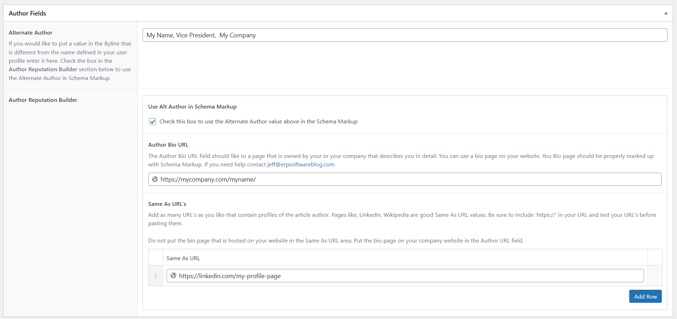

Slide 9
Personal Author Pages.
Your company website should include bio pages for key employees.
Best practice is to use Schema Markup code to signal content on the page to Google.
Schema Markup is challenging to program and can be replaced with a well-structured resume-type presentation.

Slide 10
Information for Bio Pages
Photo
Professional Background
Areas of Expertise
Verifiable Credentials (with links if possible)
Pre-able text should demonstrate
      Direct Involvement
      Personal Knowledge
      Specific examples
Update the information regularly.

Slide 11
Potential Impact of Personal Authorship on SEO
From Google Documentation
“Understanding who is responsible for a website and who created the content is a critical part of assessing E-E-A-T. This allows us to understand if the content creator has relevant experience, expertise, authority, and trustworthiness.”
"Make it clear who created the content and for what purpose. Include information that demonstrates first-hand experience.“
"Content should demonstrate first-hand expertise and a depth of knowledge (e.g., expertise that comes from having actually used a product or service, or visiting a place)."

Slide 12
Summary
Not all content needs to be authored by a person.
Personal attribution is a tool to vary your content and test results.
Well-written personal content naturally provides a unique perspective that Google claims it prefers.

